Slide 1

Statistical Matching Meeting
March 24th, 2003

Slide 2
Statistical Matching: Overview
Combines data from two or more sources
Observations must represent the same population (e.g., tax units)
Used primarily as input to microsimulation
Alternative is imputation
First match in U.S. for tax policy analysis (Okner, 1968)
Urban-Brookings Tax Policy Center

Slide 3
Statistical Matching: Definitions and Terminology
One file is HOST file (FILE A, mother file, or recipient file)
Second file is DONOR file (FILE B, child, or auxiliary file)
Common variables appear on both files, possibly transformed (“X”-variables)
Variables of interest are not found on other file (“Y”- and “Z”- variables)
Two categories of statistical matching: constrained and unconstrained
Urban-Brookings Tax Policy Center

Slide 4
Statistical Matching:Constrained Matching
Creates final matched data set (file C) that contains all records from files A and B
Limits the number of times records from file B may match to records from file A
Often splits records from both files
  uses records more than once
  using all population weights in the match
Urban-Brookings Tax Policy Center

Slide 5
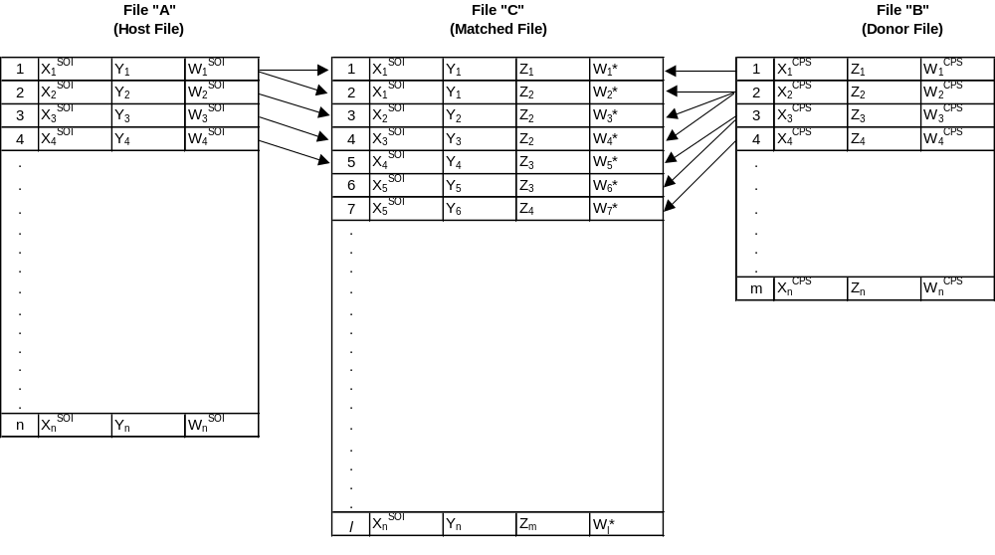
Constrained Matching:
Standard Setup
Urban-Brookings Tax Policy Center

Slide 6
Statistical Matching:
Constrained Matching
Both input files have the same weighted population totals
  Necessary condition for constrained matching
  Very difficult to meet in practice
  Scale weights on Donor file to match Host
Urban-Brookings Tax Policy Center

Slide 7
Pros & Cons of Constrained Matching
Properties of data files constructed by a constrained match:
  preserves means and variances of X, Y, Z variables (as a consequence of constraints imposed on the weights in final matched data set)
  in some cases, results in unacceptably large distances between X-variables
  Can make large demand on system resources
Urban-Brookings Tax Policy Center

Slide 8
Constrained Matching: Linear Programming Approach
Minimize the overall distance between records on Files A and B appearing in File C
  mathematically, minimize:
    Σ_{i} Σ_{j} (d_{ij} * w_{ij})
    subject to: Σ_{j} w_{ij} = a_{i} and Σ_{i}w_{ij} = b
    a_{i} and b_{j} are the original weights on File A and File B and,
    w_{ij} is the weight on File C from matching the (File A) ith record with the (File B) jth record
Urban-Brookings Tax Policy Center

Slide 9
Constrained Matching: Linear Programming Approach (Cont.)
Structure of this minimization problem is the transportation (or transshipment) problem in network optimization.
Paass (1985) and Rogers (1984) favor constrained matching, believing additional costs outweigh possible errors introduced from unconstrained matching
Urban-Brookings Tax Policy Center

Slide 10
Statistical Matching:
Unconstrained Matching
Does not require the use of all donor records (File B)
Each host file record appears in the final match (in almost every case)
Imposes certain limitations on the number of times donor records are used
Must ensure that the weighted distributions of variables “brought over” align closely with distributions found on original file
Urban-Brookings Tax Policy Center

Slide 11
Statistical Matching:
Unconstrained Matching
Often referred to as “Hot Decking”, but this is a misnomer:
  In hot decking, donor file is not statistically representative in the same manner as the host file
  Unconstrained matching is more popular choice for microsimulation models since there are fewer system demands
Urban-Brookings Tax Policy Center

Slide 12
Statistical Matching:
Unconstrained Case
Seek a record in donor file “close” to record in host file
Use Euclidean distance normalized by standard deviation:
    d_{ij} = [Σ_{k} (( X^{A}_{ik} - X^{B}_{jk} ) / σ_{k})² ] ^{1/2}
    construct the distance function using
    X^{A}_{i1}, X^{A}_{i2}, ..... X^{A}_{in} X-variables from record i in File A and
    X^{B}_{j1}, X^{B}_{j2}, ......, X^{B}_{jn} similar values of the same variables from record j in File B
Urban-Brookings Tax Policy Center

Slide 13
Statistical Matching:
Unconstrained Matching
Choosing appropriate distance function influences integrity of the matched file
Minimum distance or nearest neighbor match:
  first large-scale statistical matching method in microsimulation
  select record in file B that is “minimum distance” from each record in file A( “nearest-neighbor” matching
  marginal distributions of Z-variables may be different than those on the original file
Urban-Brookings Tax Policy Center

Slide 14
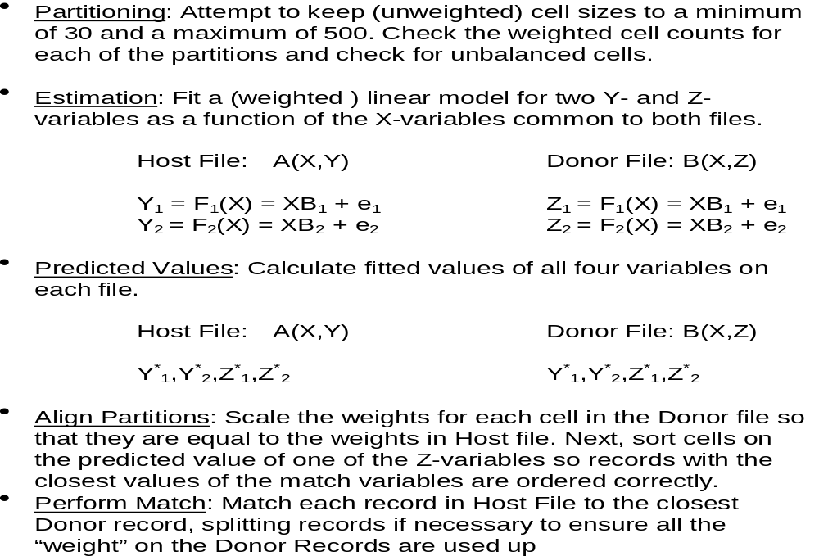
Statistical Matching:
Predictive Mean Matching
Urban-Brookings Tax Policy Center

